Slide 1
6.852: Distributed Algorithms Fall, 2015
Lecture 11

Slide 2
Today’s plan
Basic asynchronous network algorithms, general networks:
Leader election
(Arbitrary) spanning trees
Breadth-first spanning trees
Shortest-paths spanning trees
Minimum Spanning Trees (MSTs)
Readings:
Chapter 15
[Gallager, Humblet, Spira]
Next time:
Synchronizers
Reading: Chapter 16.

Slide 3
Leader Election in General Networks

Slide 4
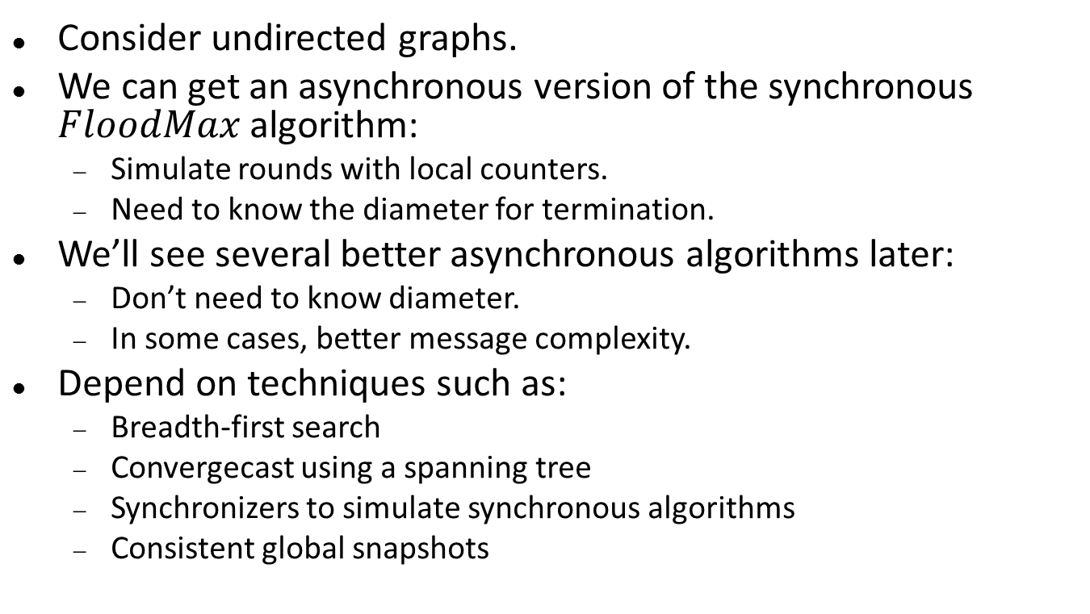
Leader election in general networks
Consider undirected graphs.
We can get an asynchronous version of the synchronous $FloodMax$ algorithm:
Simulate rounds with local counters.
Need to know the diameter for termination.
We’ll see several better asynchronous algorithms later:
Don’t need to know diameter.
In some cases, better message complexity.
Depend on techniques such as:
Breadth-first search
Convergecast using a spanning tree
Synchronizers to simulate synchronous algorithms
Consistent global snapshots
Notes:
The consistent global shapshots can be used to detect termination.

Slide 5
Spanning Trees and Searching

Slide 6
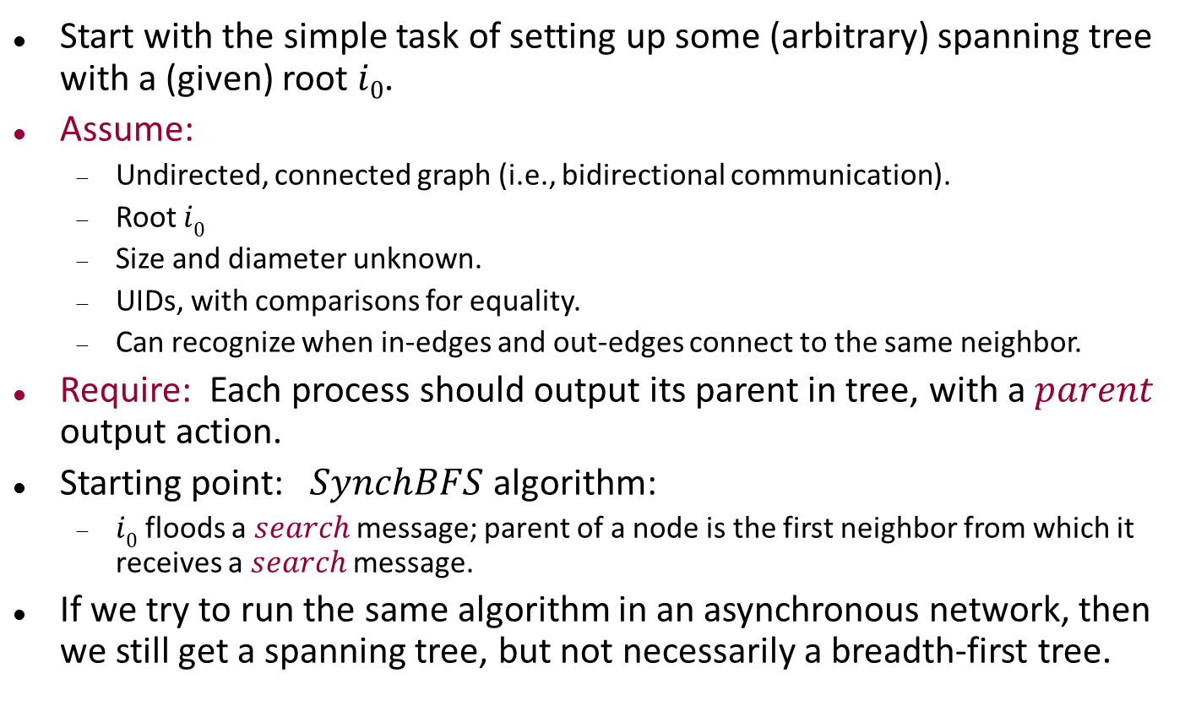
Spanning trees and searching
Start with the simple task of setting up some (arbitrary) spanning tree with a (given) root $i0$.
Assume:
Undirected, connected graph (i.e., bidirectional communication).
Root $i0$
Size and diameter unknown.
UIDs, with comparisons for equality.
Can recognize when in-edges and out-edges connect to the same neighbor.
Require: Each process should output its parent in tree, with a $parent$ output action.
Starting point: $SynchBFS$ algorithm:
$i0$ floods a $search$ message; parent of a node is the first neighbor from which it receives a $search$ message.
If we try to run the same algorithm in an asynchronous network, then we still get a spanning tree, but not necessarily a breadth-first tree.

Slide 7
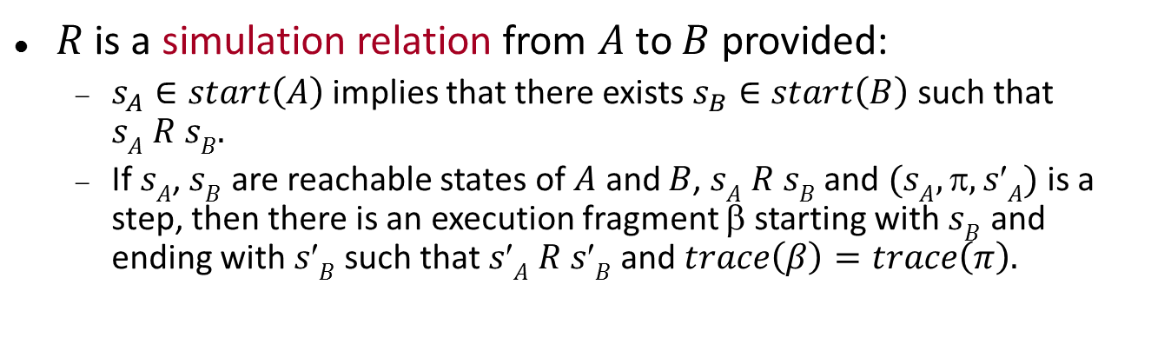
$AsynchSpanningTree$, Process $i$
Signature
in receive(search)_{j,i}, j ∈ nbrs
out send(search)_{i,j}, j ∈ nbrs
out parent(j)_{i}, j ∈ nbrs
State
parent: nbrs U { ⊥ }, init ⊥
reported: Boolean, init false
for each j ∈ nbrs:
send(j) ∈ {search, ⊥}, init search if i = i₀, else ⊥
send(search)_{i,j} pre: send(j) = search eff: send(j) := ⊥
receive(search)_{j,i} eff: if i ≠ i₀ and parent = ⊥ then parent := j for k ∈ nbrs - { j } do send(k) := search
parent(j)_{i} pre: parent = j reported = false eff: reported := true
Notes:
Notice that the process ignores an incoming message if it already has its parent determined.

Slide 8
AsynchSpanningTree
Notes:
The black dots represent the search messages in local send buffers.

Slide 9
AsynchSpanningTree
s
Notes:
Send a message.

Slide 10
AsynchSpanningTree
s
s
Notes:
Send another message.
Disambiguating who sent by having the s on the left-hand side of the line, from the sender’s viewpoint.

Slide 11
AsynchSpanningTree
s
Notes:
Arrival of a message at the middle node, producing three messages in its send buffers and also setting the parent pointer for the recipient node (reverse the arrow in the diagram).

Slide 12
AsynchSpanningTree
s
Notes:
This shows the result of two more steps:
Arrival of one message at the “valley” node, causing two messages to be placed in its send buffers and causing its parent pointer to be set, and
Sending of a message by the middle node.

Slide 13
AsynchSpanningTree
s
s
Notes:
And several more steps. The “middle” node sends a message from its buffer.
Then the valley node sends a message, which gets relayed to the rightmost node.
Two more parent pointers are set.

Slide 14
AsynchSpanningTree
s
Notes:
Now the two rightmost messages in send buffers are sent and then arrive at the bottom node, with the rightmost arriving first.
From there a message is sent to the lower left node, resulting in two messages in its local buffers.

Slide 15
AsynchSpanningTree
s
s
s
Notes:
Now a message arrives from the middle node to the lower left, with no effect, since the node already has a parent.
Then three more messages in buffers are sent.

Slide 16
AsynchSpanningTree
Notes:
The message to the left node arrives, setting the parent pointer.
The other messages arrive, having no effect.
The final message from the root is sent and arrives, with no effect.
So this shows the final spanning tree.
It’s not breadth-first.

Slide 17

AsynchSpanningTree
Complexity
Messages: $O( |E| )$
Time: $diam (l+d) + l$
Anomaly: Paths may be longer than the diameter!
Messages may travel faster along longer paths, in asynchronous networks.
Notes:
Time is bounded linearly in terms of the diameter because time to reach nodes at distance k from i0 is bounded linearly in terms of k.
Can prove this by induction on k.
No pile-ups to worry about here.

Slide 18
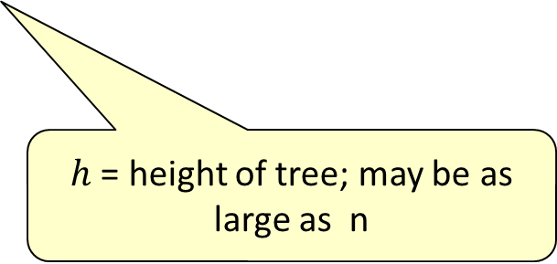
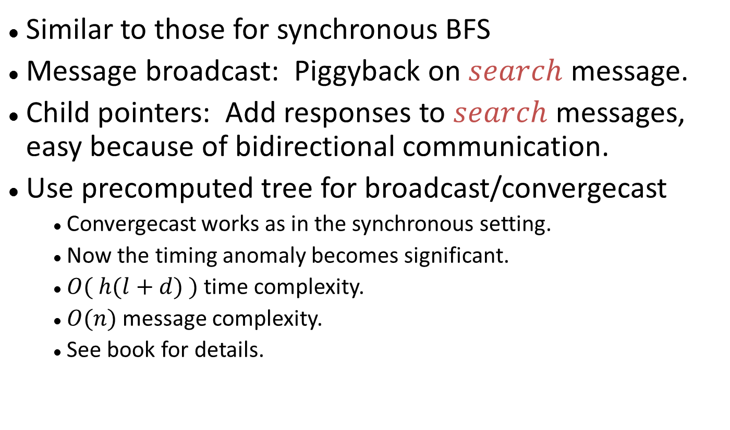
Applications of AsynchSpanningTree
Similar to those for synchronous BFS
Message broadcast: Piggyback on $search$ message.
Child pointers: Add responses to $search$ messages, easy because of bidirectional communication.
Use precomputed tree for broadcast/convergecast
Convergecast works as in the synchronous setting.
Now the timing anomaly becomes significant.
$O( h(l+d) )$time complexity.
$O(n)$message complexity.
See book for details.
$h$ = height of tree; may be as large as n
Notes:
Convergecast works as in the synchronous setting: leafs initiate responses, internal nodes wait for responses from children before sending response to parent.

Slide 19
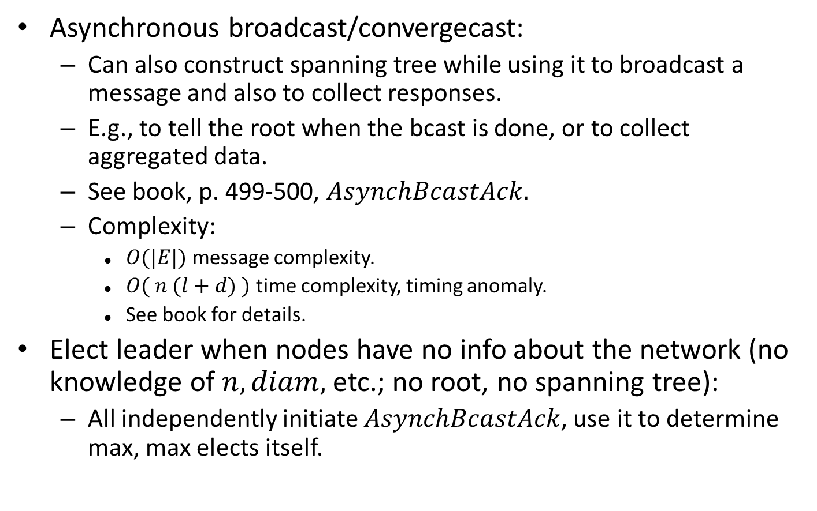
More applications
Asynchronous broadcast/convergecast:
Can also construct spanning tree while using it to broadcast a message and also to collect responses.
E.g., to tell the root when the bcast is done, or to collect aggregated data.
See book, p. 499-500, $AsynchBcastAck.$
Complexity:
$O(|E|)$message complexity.
$O( n (l+d) )$time complexity, timing anomaly.
See book for details.
Elect leader when nodes have no info about the network (no knowledge of $n, diam,$etc.; no root, no spanning tree):
All independently initiate $AsynchBcastAck$, use it to determine max, max elects itself.

Slide 20
Breadth-First Spanning Trees

Slide 21
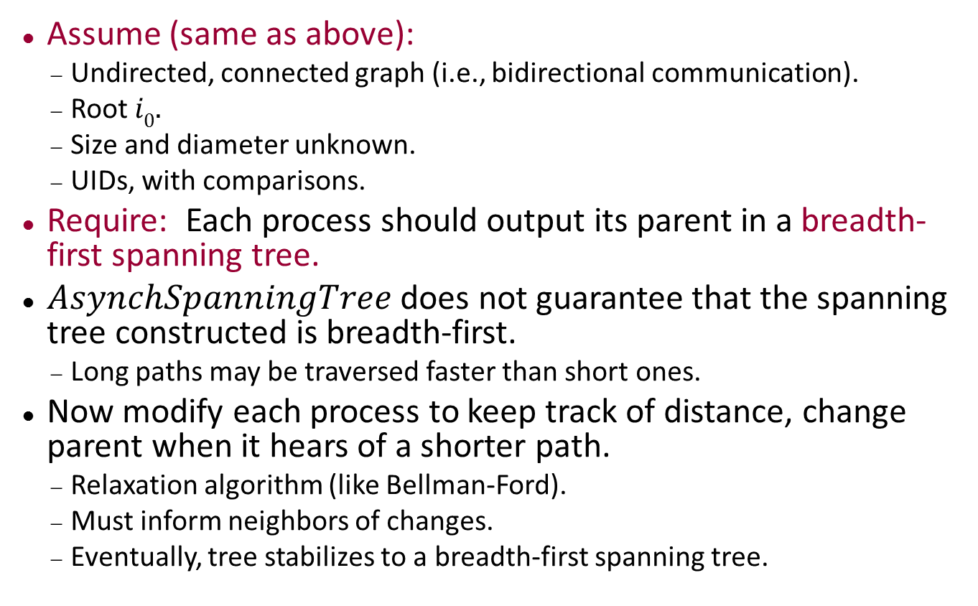
Breadth-first spanning trees
Assume (same as above):
Undirected, connected graph (i.e., bidirectional communication).
Root $i0.$
Size and diameter unknown.
UIDs, with comparisons.
Require: Each process should output its parent in a breadth-first spanning tree.
$AsynchSpanningTree$ does not guarantee that the spanning tree constructed is breadth-first.
Long paths may be traversed faster than short ones.
Now modify each process to keep track of distance, change parent when it hears of a shorter path.
Relaxation algorithm (like Bellman-Ford).
Must inform neighbors of changes.
Eventually, tree stabilizes to a breadth-first spanning tree.
Notes:
Now we have a relaxation algorithm, just to get a BF tree. In the synchronous case, we didn’t need relaxation here, but only when we introduced weights.

Slide 22

$$AsynchBFS$$
Signature
in receive(m)_{j,i}, m ∈ N, j ∈ nbrs
out send(m)_{i,j}, m ∈ N, j ∈ nbrs
State
dist: N U { ∞ }, initially 0 if i = i₀, else ∞
parent: nbrs U { ⊥ }, init ⊥
for each j ∈ nbrs:
send(j): FIFO queue of N, initially (0) if i = i₀, else empty
send(m)_{i,j} pre: m = head(send(j)) eff: remove head of send(j)
receive(m)_{j,i} eff: if m+1 < dist then dist := m +1 parent := j for k ∈ nbrs - { j } do add dist to send(k)
Note: No parent output actions---no one
knows when the algorithm is done

Slide 23
AsynchBFS
0
Notes:
Following the same order of steps as for AsynchSpanningTree, but now with distances and corrections.

Slide 24
AsynchBFS
0
0
Notes:
Direction of messages indicated by putting the message on the left of the outgoing edge.

Slide 25
AsynchBFS
0
0
0

Slide 26
AsynchBFS
0
0
1

Slide 27
AsynchBFS
0
1
1
1
Notes:
Not representing the messages going back to the parent---we don’t actually need them.

Slide 28
AsynchBFS
0
2
1
1
3
1
1

Slide 29
AsynchBFS
0
2
1
1
3
1
1
4

Slide 30
AsynchBFS
0
2
1
1
3
1
4
1
4
4

Slide 31
AsynchBFS
0
2
1
1
3
4
1
2
4
Notes:
Here we have a correction, when the message from the middle node arrives at the lower node. Instead of discarding it as in AsynchSpanningTree, now the estimate is lowered from 4 to 2.

Slide 32
AsynchBFS
0
2
1
1
1
3
1
5
2
2
Notes:
One 4 message arrives and gets ignored.
Another arrives and causes a dist to be set to 5.
The bottom node sends out 2.
The valley node sends out 1.

Slide 33
AsynchBFS
0
2
6
1
1
1
3
1
5
2
2
Notes:
Messages from the 5-node get sent and received.

Slide 34
AsynchBFS
0
2
6
1
1
1
3
1
3
2
Notes:
Another correction, lower left from 5 to 3.

Slide 35
AsynchBFS
0
2
6
1
1
1
1
3
2
2
Notes:
And corrected yet again, from 3 to 2.

Slide 36
AsynchBFS
0
2
0
2
1
1
1
3
2
2
Notes:
And a correction from 6 to 2.

Slide 37
AsynchBFS
0
2
1
1
1
3
2
2
Notes:
And a final correction on the left, from 2 to 1.

Slide 38
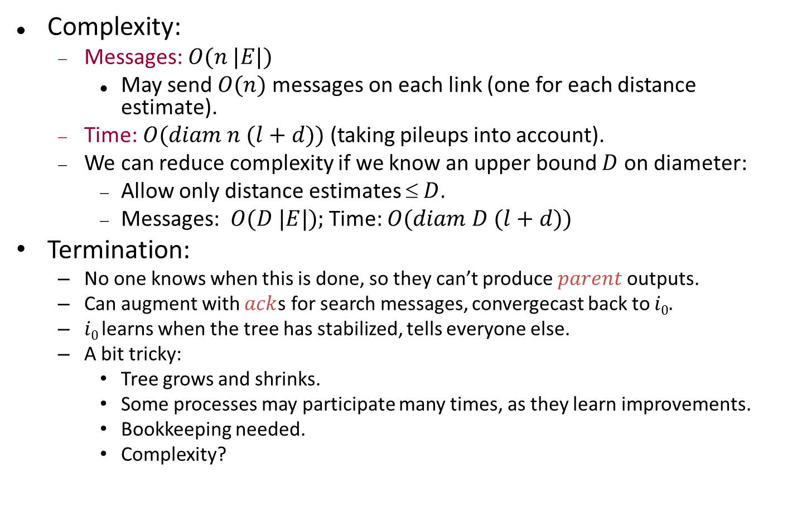
AsynchBFS
Complexity:
Messages: $O(n |E|)$
May send $O(n)$ messages on each link (one for each distance estimate).
Time: $O(diam n (l+d))$(taking pileups into account).
We can reduce complexity if we know an upper bound $D$ on diameter:
Allow only distance estimates $ D$.
Messages: $O(D |E|);$Time: $O(diam D (l+d))$
Termination:
No one knows when this is done, so they can’t produce $parent$ outputs.
Can augment with $ack$s for search messages, convergecast back to $i0.$
$i0$learns when the tree has stabilized, tells everyone else.
A bit tricky:
Tree grows and shrinks.
Some processes may participate many times, as they learn improvements.
Bookkeeping needed.
Complexity?
Notes:
For the time bound, the shortest path info has to propagate at most diam steps. But at each hop, the message could be behind other messages, at most n of them.
Actually, the bound should be better than this because of a pipelining effect. As we have seen before.
Discuss the new type of convergecast.

Slide 39
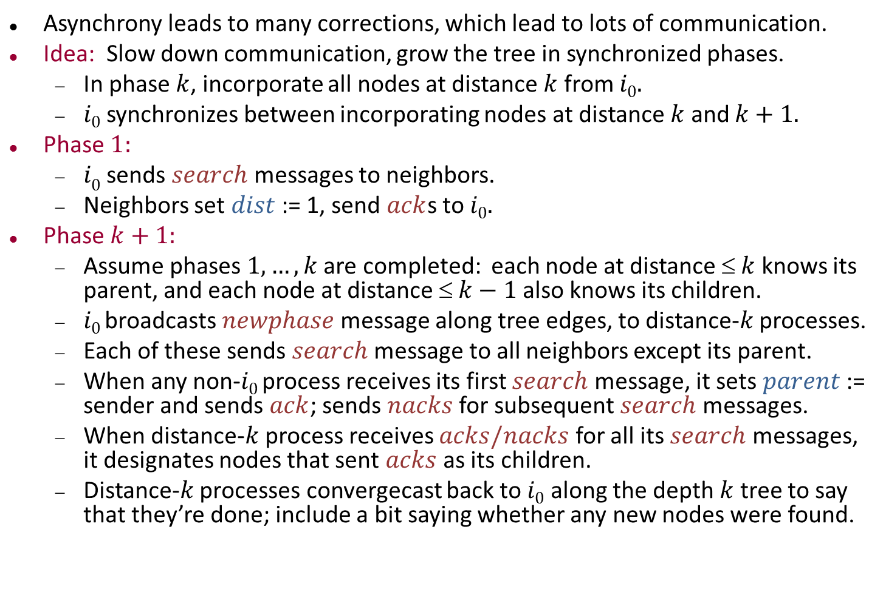
Layered BFS
Asynchrony leads to many corrections, which lead to lots of communication.
Idea: Slow down communication, grow the tree in synchronized phases.
In phase $k$, incorporate all nodes at distance $k$ from $i0.$
$i0$ synchronizes between incorporating nodes at distance $k$ and $k+1.$
Phase $1:$
$i0$ sends $search$ messages to neighbors.
Neighbors set $dist$ := 1, send $ack$s to $i0.$
Phase $k+1:$
Assume phases $1,…,k$are completed: each node at distance $ k$ knows its parent, and each node at distance $ k−1$also knows its children.
$i0$broadcasts $newphase$message along tree edges, to distance-$k$ processes.
Each of these sends $search$ message to all neighbors except its parent.
When any non-$i0$ process receives its first $search$ message, it sets $parent$ := sender and sends $ack$; sends $nacks$ for subsequent $search$ messages.
When distance-$k$ process receives $acks/nacks$ for all its $search$ messages, it designates nodes that sent $acks$as its children.
Distance-$k$ processes convergecast back to $i0$ along the depth $k$ tree to say that they’re done; include a bit saying whether any new nodes were found.
Notes:
From Baruch Awerbuch

Slide 40
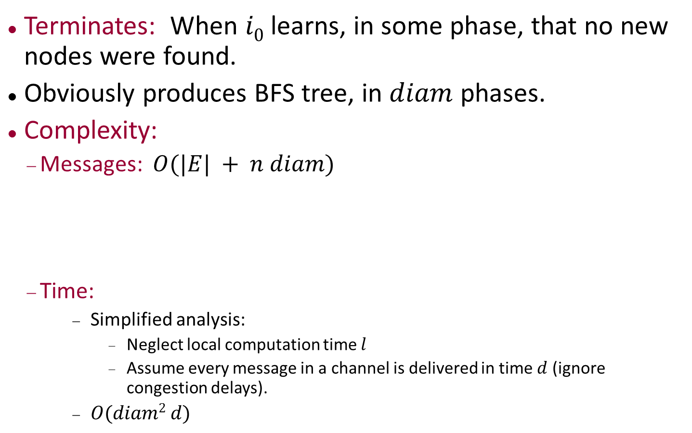
Layered BFS
Terminates: When $i0$ learns, in some phase, that no new nodes were found.
Obviously produces BFS tree, in $diam$ phases.
Complexity:
Messages: $O(|E| + n diam)$
Time:
Simplified analysis:
Neglect local computation time $l$
Assume every message in a channel is delivered in time $d$ (ignore congestion delays).
$O(diam2 d)$
Each edge is explored at most once in each direction by search/ack.
Each tree edge is traversed at most once in each phase by newphase/convergecast.
Notes:
We have diam phases.
Messages: O(|E|) search/ack messages because each edge is explored once in each direction.
The n diam messages arise because each tree edge is traversed at most once by newphase/convergecast messages at each phase.
For the time analysis, we have diam phases, each of which takes time at most diam d.

Slide 41
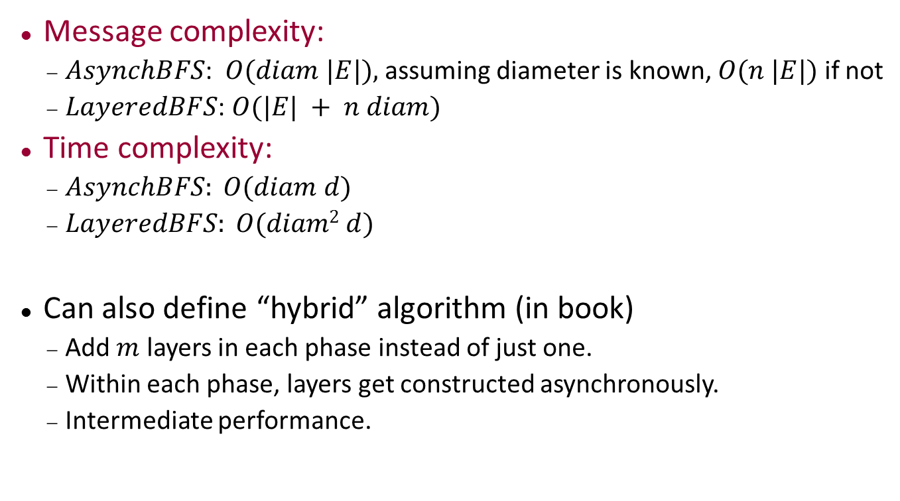
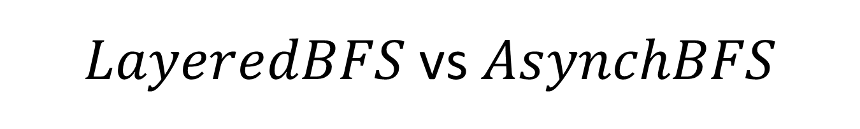
$LayeredBFS$ vs $AsynchBFS$
Message complexity:
$AsynchBFS$: $O(diam |E|),$assuming diameter is known, $O(n |E|)$if not
$LayeredBFS$: $O(|E| + n diam)$
Time complexity:
$AsynchBFS: O(diam d)$
$LayeredBFS: O(diam2 d)$
Can also define “hybrid” algorithm (in book)
Add $m$ layers in each phase instead of just one.
Within each phase, layers get constructed asynchronously.
Intermediate performance.
Notes:
These comparisons are neglecting local processing time l and pileups.
LayeredBFS improves on communication, but at a cost in time.
Message complexity for AsynchBFS: If diam is known, we need consider only diam different estimates along each edge (only estimates of size \leq diam).
Time complexity for AsynchBFS: Because we are ignoring the pileups in the channels. Each shortest path gets traversed in just diam d time.

Slide 42
Shortest-Paths Spanning Trees

Slide 43
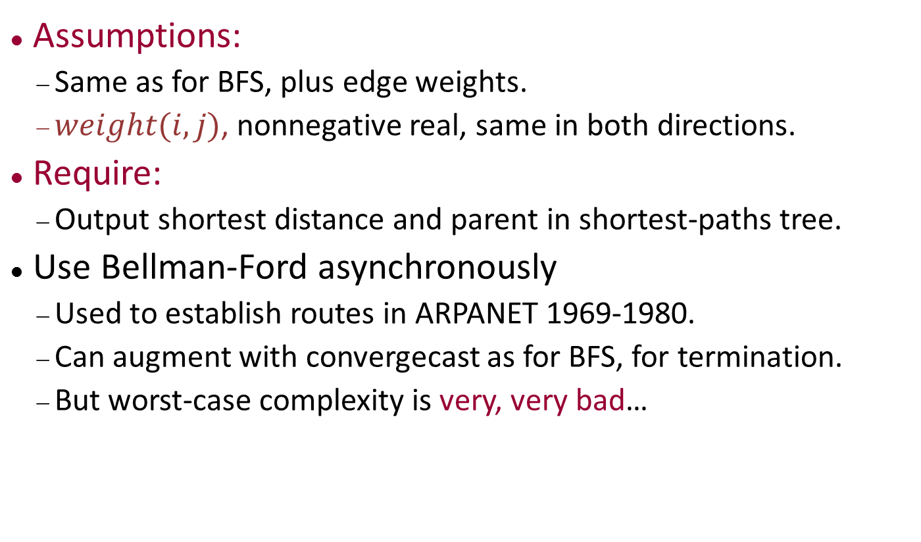
Shortest paths
Assumptions:
Same as for BFS, plus edge weights.
$weight(i,j)$, nonnegative real, same in both directions.
Require:
Output shortest distance and parent in shortest-paths tree.
Use Bellman-Ford asynchronously
Used to establish routes in ARPANET 1969-1980.
Can augment with convergecast as for BFS, for termination.
But worst-case complexity is very, very bad…

Slide 44
AsynchBellmanFord
Signature
in receive(w)_{j,i}, w ∈ R^{≥0}, j ∈ nbrs
out send(w)_{i,j}, w ∈ R^{≥0}, j ∈ nbrs
State
dist: R^{≥0} U { ∞ }, initially 0 if i = i₀, else ∞
parent: nbrs U { ⊥ }, init ⊥
for each j ∈ nbrs:
send(j): FIFO queue of R^{≥0}; init (0) if i = i₀, else empty
Transitions
send(w)_{i,j}
pre: w = head(send(j))
eff: remove head of send(j)
receive(w)_{j,i} eff: if w + weight(j,i) < dist then dist := w + weight(j,i) parent := j for k ∈ nbrs - { j } do add dist to send(k)

Slide 45
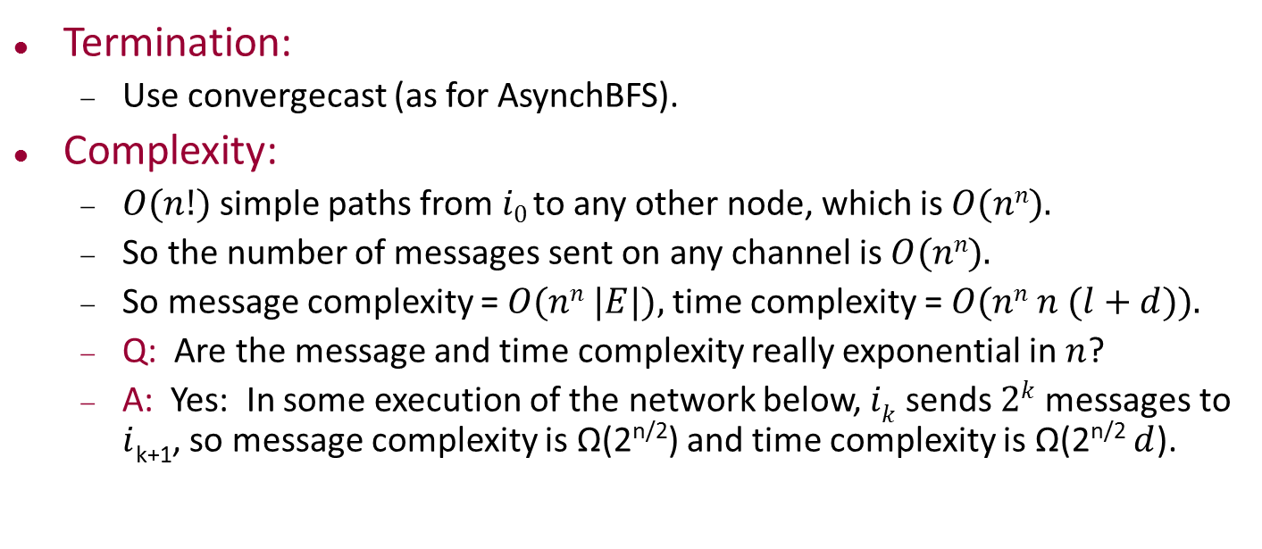
AsynchBellmanFord
Termination:
Use convergecast (as for AsynchBFS).
Complexity:
$O(n!)$simple paths from $i0$ to any other node, which is $O(nn).$
So the number of messages sent on any channel is $O(nn).$
So message complexity = $O(nn |E|),$time complexity = $O(nn n (l+d)).$
Q: Are the message and time complexity really exponential in $n$?
A: Yes: In some execution of the network below, $ik$ sends $2k$ messages to $i$_{k+1}, so message complexity is Ω(2^{n/2}) and time complexity is Ω(2^{n/2} $d$).
0
2^{k-1}
0
2^{k-2}
2¹
0
2⁰
i₀
i₁
i₂
i_{k-1}
i_{k}
i_{k+1}
0
0
0
0

Slide 46
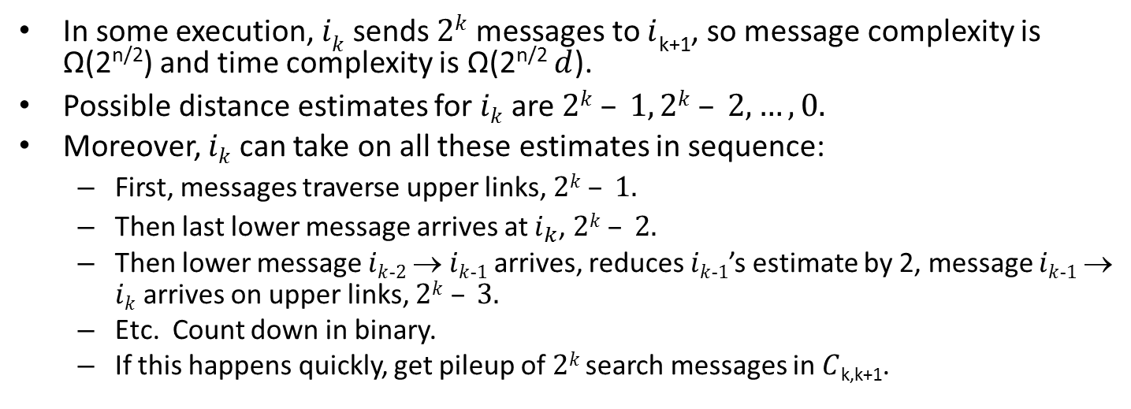
Exponential time/message complexity
In some execution, $ik$ sends $2k$ messages to $i$_{k+1}, so message complexity is Ω(2^{n/2}) and time complexity is Ω(2^{n/2} $d$).
Possible distance estimates for $ik$ are $2k – 1, 2k – 2,…,0.$
Moreover, $ik$ can take on all these estimates in sequence:
First, messages traverse upper links, $2k – 1.$
Then last lower message arrives at $i_{k}$, $2k – 2.$
Then lower message $ik$₋$2$ → $ik$₋$1$ arrives, reduces $ik$₋$1$’s estimate by 2, message $ik$₋$1$→ $ik$ arrives on upper links, $2k – 3.$
Etc. Count down in binary.
If this happens quickly, get pileup of $2k$ search messages in $C$_{k,k+1}.
0
2^{k-1}
0
2^{k-2}
2¹
0
2⁰
i₀
i₁
i₂
i_{k-1}
i_{k}
i_{k+1}
0
0
0
0

Slide 47
Shortest Paths
Moral: Unrestrained asynchrony can cause problems.
Return to this problem after we have better synchronization methods.
Now, another good illustration of the problems introduced by asynchrony:

Slide 48
Minimum Spanning Tree

Slide 49
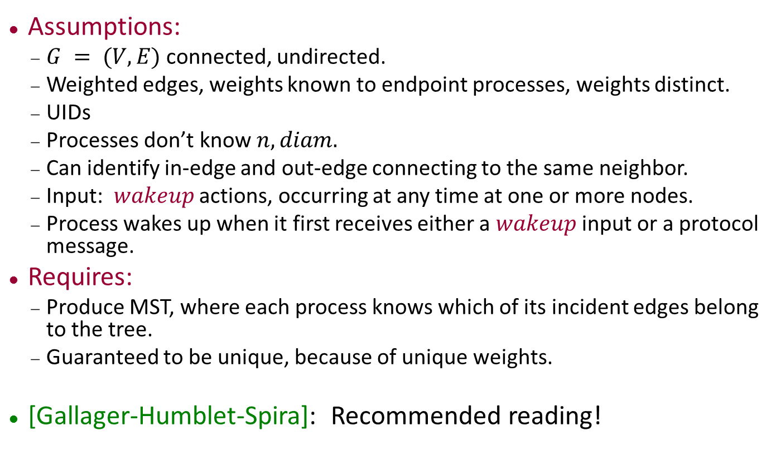
Minimum spanning tree
Assumptions:
$G = (V,E)$connected, undirected.
Weighted edges, weights known to endpoint processes, weights distinct.
UIDs
Processes don’t know $n, diam.$
Can identify in-edge and out-edge connecting to the same neighbor.
Input: $wakeup$ actions, occurring at any time at one or more nodes.
Process wakes up when it first receives either a $wakeup$ input or a protocol message.
Requires:
Produce MST, where each process knows which of its incident edges belong to the tree.
Guaranteed to be unique, because of unique weights.
[Gallager-Humblet-Spira]: Recommended reading!

Slide 50
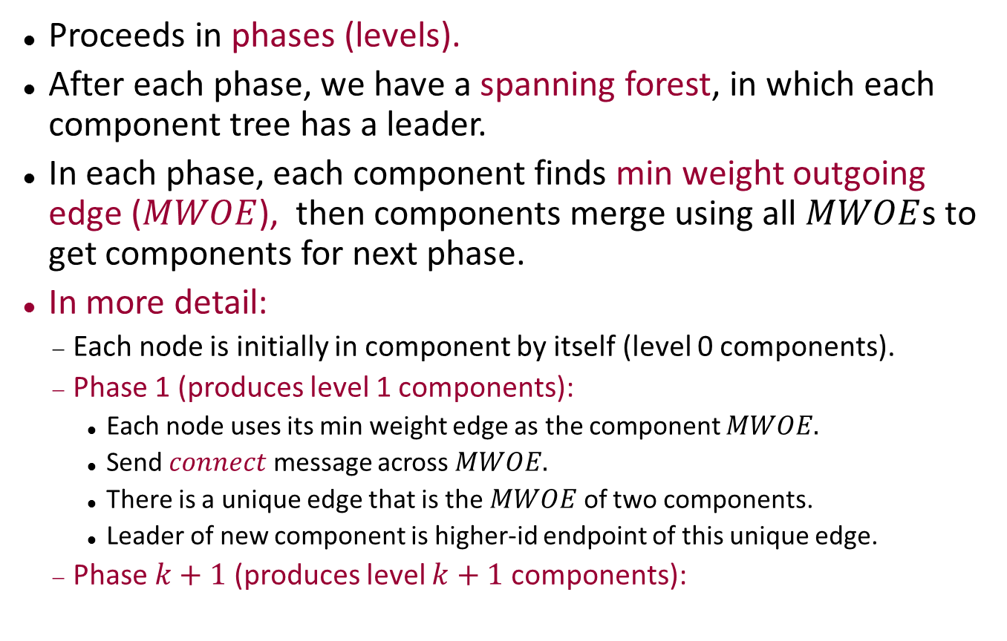
Recall synchronous algorithm
Proceeds in phases (levels).
After each phase, we have a spanning forest, in which each component tree has a leader.
In each phase, each component finds min weight outgoing edge ($MWOE$), then components merge using all $MWOE$s to get components for next phase.
In more detail:
Each node is initially in component by itself (level 0 components).
Phase 1 (produces level 1 components):
Each node uses its min weight edge as the component $MWOE.$
Send $connect$ message across $MWOE.$
There is a unique edge that is the $MWOE$ of two components.
Leader of new component is higher-id endpoint of this unique edge.
Phase $k+1$ (produces level $k+1$ components):
Notes:
There is a unique edge in each level 1 component, that is…

Slide 51
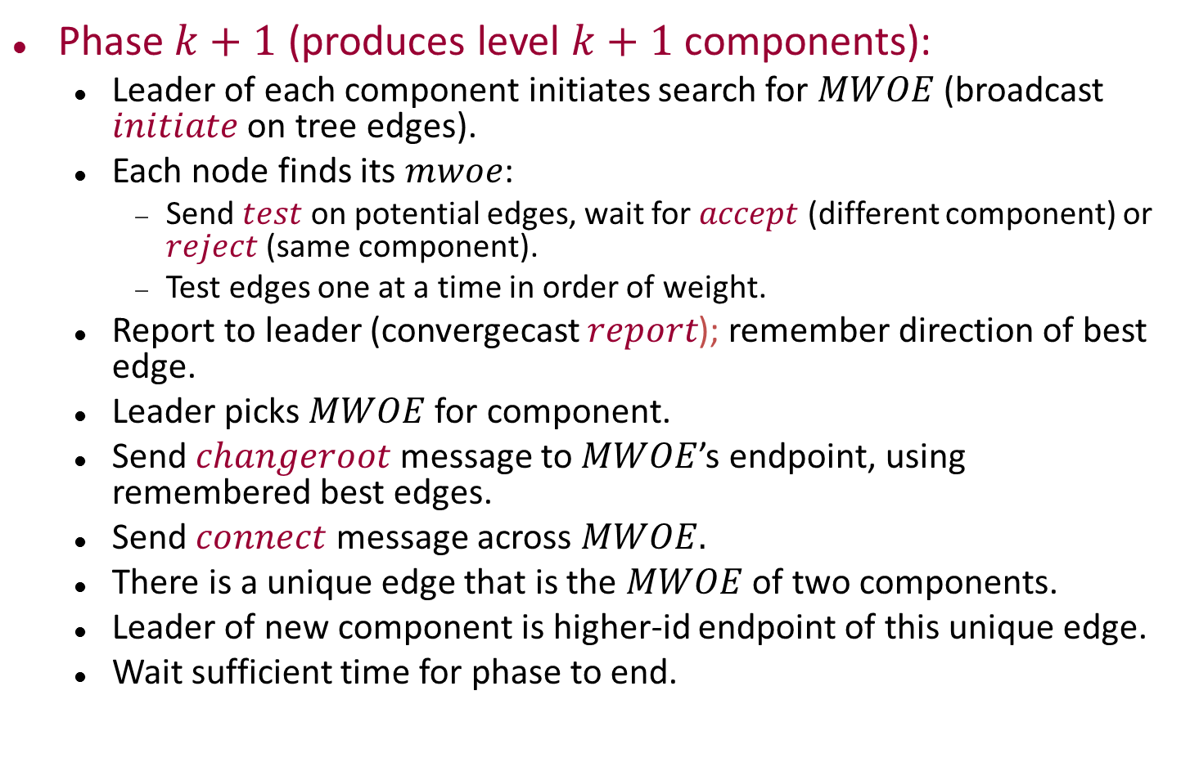
Synchronous algorithm
Phase $k+1$ (produces level $k+1$ components):
Leader of each component initiates search for $MWOE$ (broadcast $initiate$ on tree edges).
Each node finds its $mwoe$:
Send $test$ on potential edges, wait for $accept$ (different component) or $reject$(same component).
Test edges one at a time in order of weight.
Report to leader (convergecast $report$); remember direction of best edge.
Leader picks $MWOE$ for component.
Send $changeroot$ message to $MWOE$’s endpoint, using remembered best edges.
Send $connect$ message across $MWOE.$
There is a unique edge that is the $MWOE$ of two components.
Leader of new component is higher-id endpoint of this unique edge.
Wait sufficient time for phase to end.
Notes:
Unique edge in each level (k+1) component, that is.

Slide 52
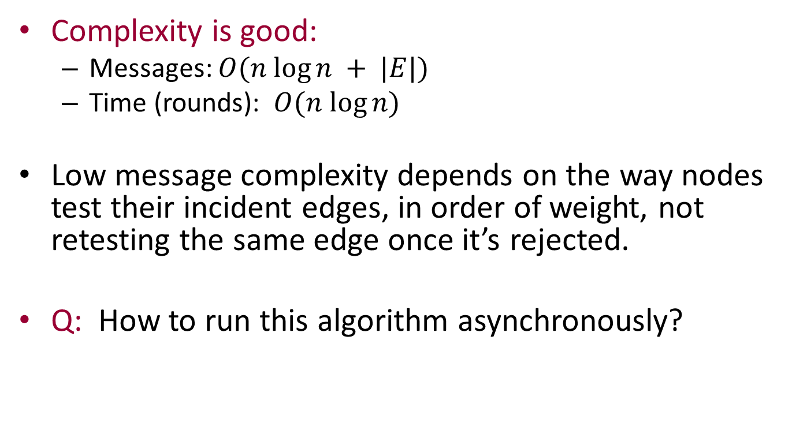
Synchronous algorithm
Complexity is good:
Messages: $O(n log⁡n + |E|)$
Time (rounds): $O(n log⁡n)$
Low message complexity depends on the way nodes test their incident edges, in order of weight, not retesting the same edge once it’s rejected.
Q: How to run this algorithm asynchronously?

Slide 53
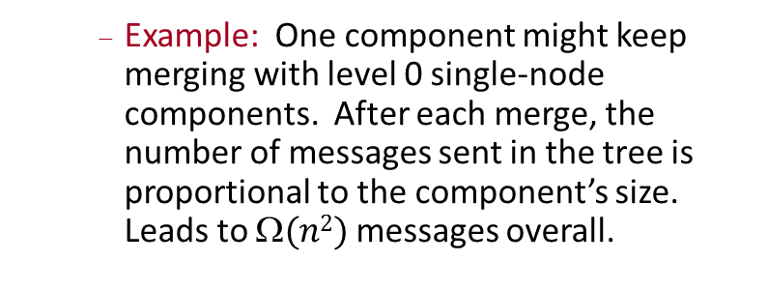
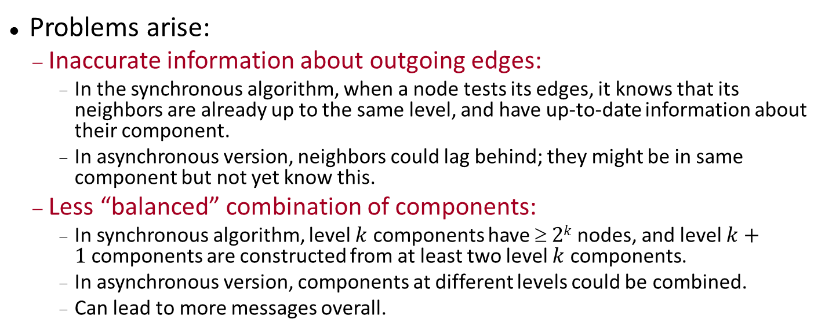
Running the algorithm asynchronously
Problems arise:
Inaccurate information about outgoing edges:
In the synchronous algorithm, when a node tests its edges, it knows that its neighbors are already up to the same level, and have up-to-date information about their component.
In asynchronous version, neighbors could lag behind; they might be in same component but not yet know this.
Less “balanced” combination of components:
In synchronous algorithm, level $k$ components have $ 2k$nodes, and level $k+1$components are constructed from at least two level $k$ components.
In asynchronous version, components at different levels could be combined.
Can lead to more messages overall.
Example: One component might keep merging with level 0 single-node components. After each merge, the number of messages sent in the tree is proportional to the component’s size. Leads to $(n2)$messages overall.

Slide 54
Running the algorithm asynchronously
Problems arise:
Inaccurate information about outgoing edges.
Less “balanced” combination of components:
Concurrent overlapping searches/convergecasts:
When nodes are out of synch, concurrent searches for MWOEs could interfere with each other (we’ll see this).
These problems result from nodes being out-of-synch, at different levels.
We could try to synchronize levels, but carefully, so as not to hurt the time and message complexity too much.

Slide 55
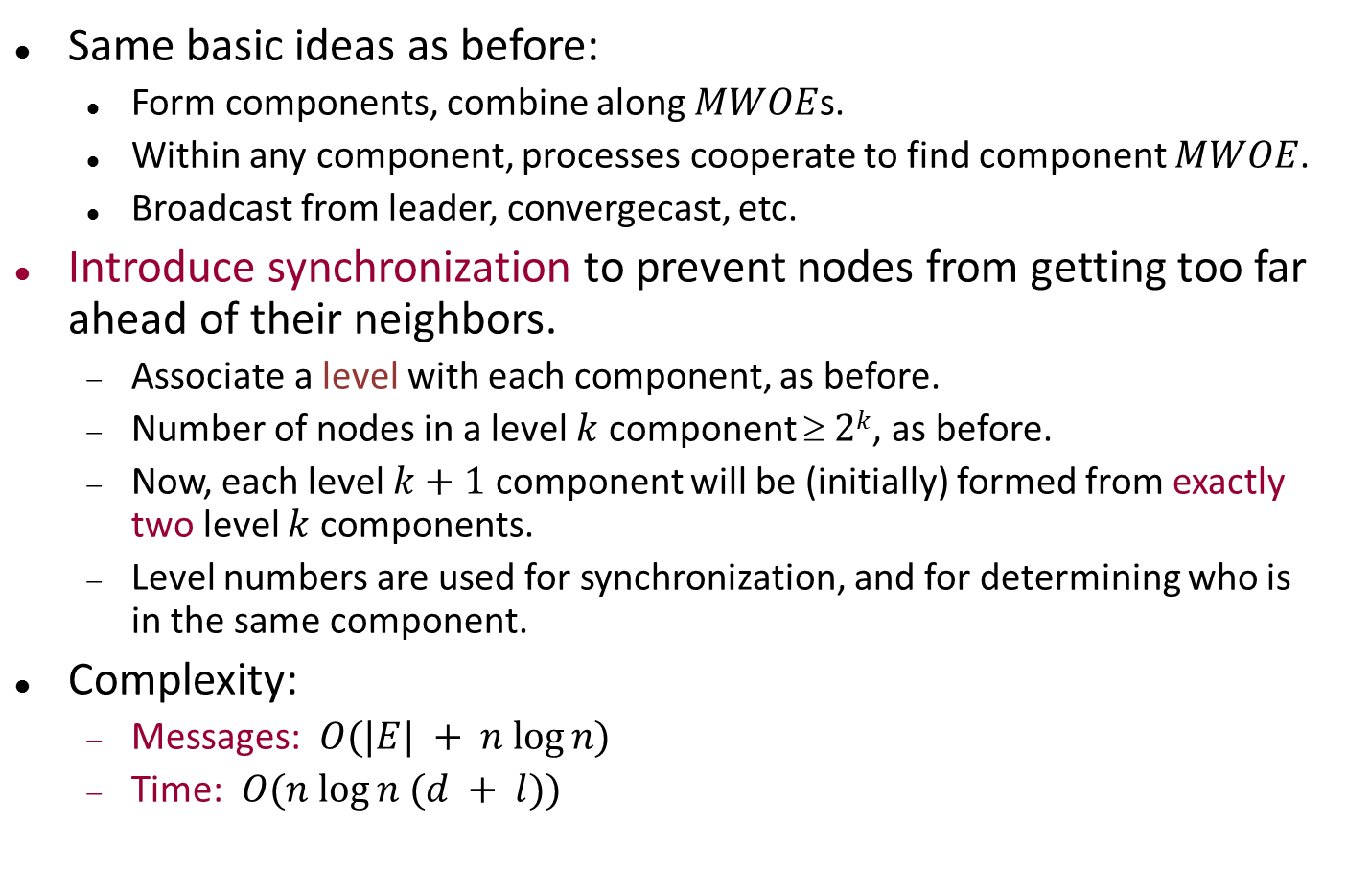
GHS algorithm (asynchronous)
Same basic ideas as before:
Form components, combine along $MWOE$s.
Within any component, processes cooperate to find component $MWOE$.
Broadcast from leader, convergecast, etc.
Introduce synchronization to prevent nodes from getting too far ahead of their neighbors.
Associate a level with each component, as before.
Number of nodes in a level $k$ component $ 2k$, as before.
Now, each level $k+1$ component will be (initially) formed from exactly two level $k$ components.
Level numbers are used for synchronization, and for determining who is in the same component.
Complexity:
Messages: $O(|E| + n log⁡n)$
Time: $O(n log⁡n (d + l))$

Slide 56
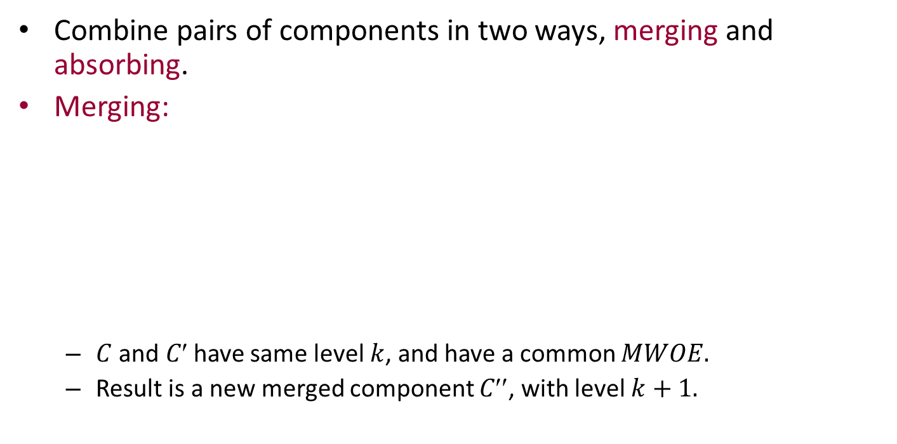
GHS algorithm
Combine pairs of components in two ways, merging and absorbing.
Merging:
$C$ and $C$have same level $k$, and have a common $MWOE.$
Result is a new merged component $C$, with level $k+1.$
C′′
C
Level k
MWOE(C)
C′
Level k
MWOE(C′)

Slide 57
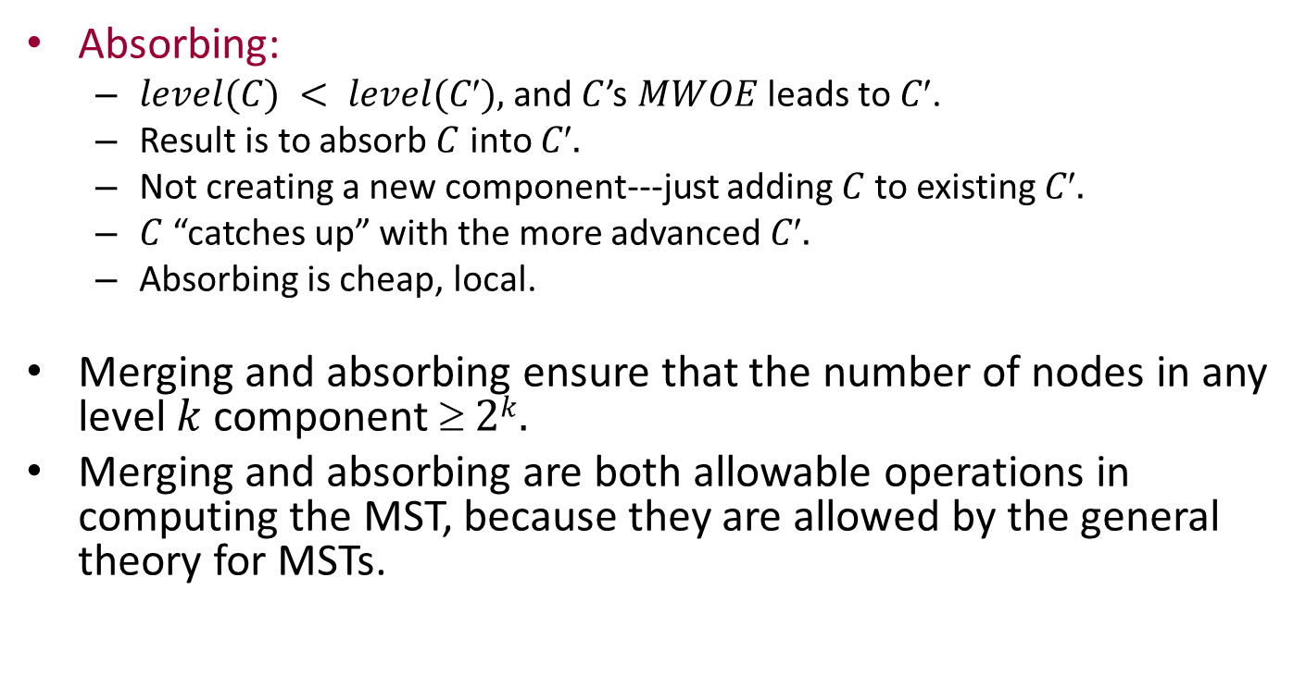
GHS algorithm
C′
C
MWOE(C)
C′
Absorbing:
$level(C) < level(C),$and $C$’s $MWOE$ leads to $C$.
Result is to absorb $C$ into $C.$
Not creating a new component---just adding $C$to existing $C.$
$C$ “catches up” with the more advanced $C.$
Absorbing is cheap, local.
Merging and absorbing ensure that the number of nodes in any level $k$component $ 2k.$
Merging and absorbing are both allowable operations in computing the MST, because they are allowed by the general theory for MSTs.
Notes:
General theory requires just that an edge being added should be the MWOE of some component.

Slide 58
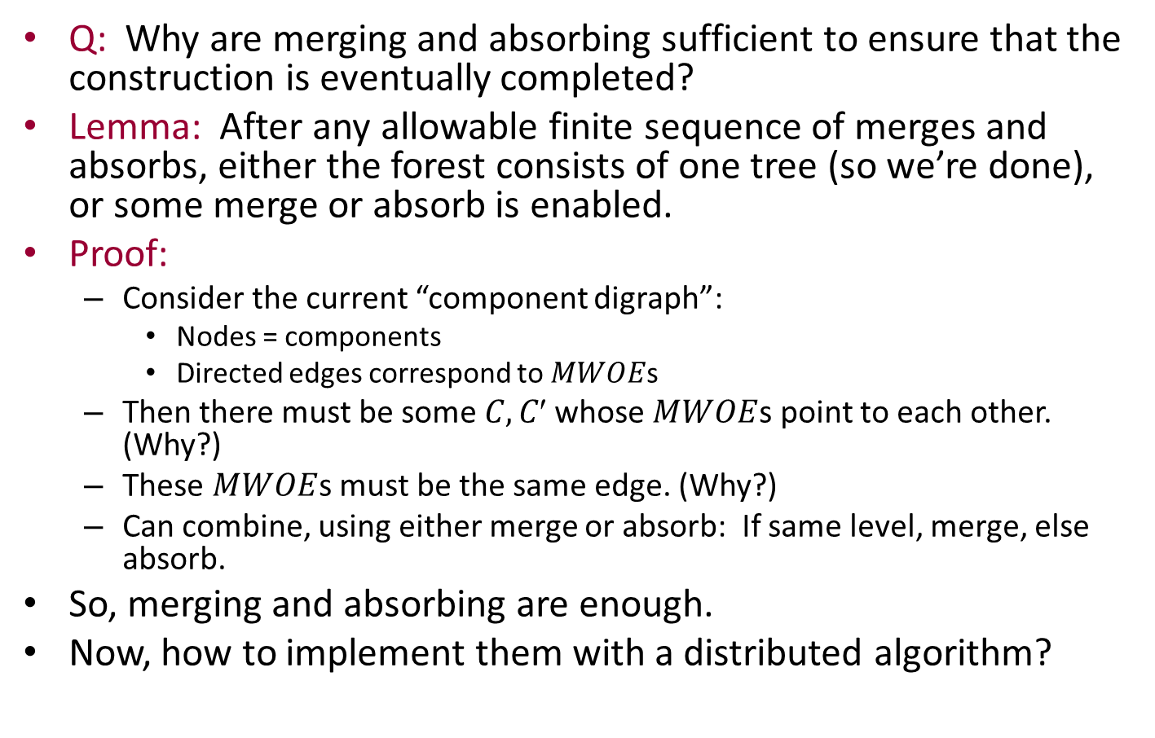
Liveness
Q: Why are merging and absorbing sufficient to ensure that the construction is eventually completed?
Lemma: After any allowable finite sequence of merges and absorbs, either the forest consists of one tree (so we’re done), or some merge or absorb is enabled.
Proof:
Consider the current “component digraph”:
Nodes = components
Directed edges correspond to $MWOE$s
Then there must be some $C, C$whose $MWOE$s point to each other. (Why?)
These $MWOE$s must be the same edge. (Why?)
Can combine, using either merge or absorb: If same level, merge, else absorb.
So, merging and absorbing are enough.
Now, how to implement them with a distributed algorithm?
Notes:
Use Lemma 4.5 in the book and a following argument about decreasing weights to show the existence of the pair C, C’.

Slide 59
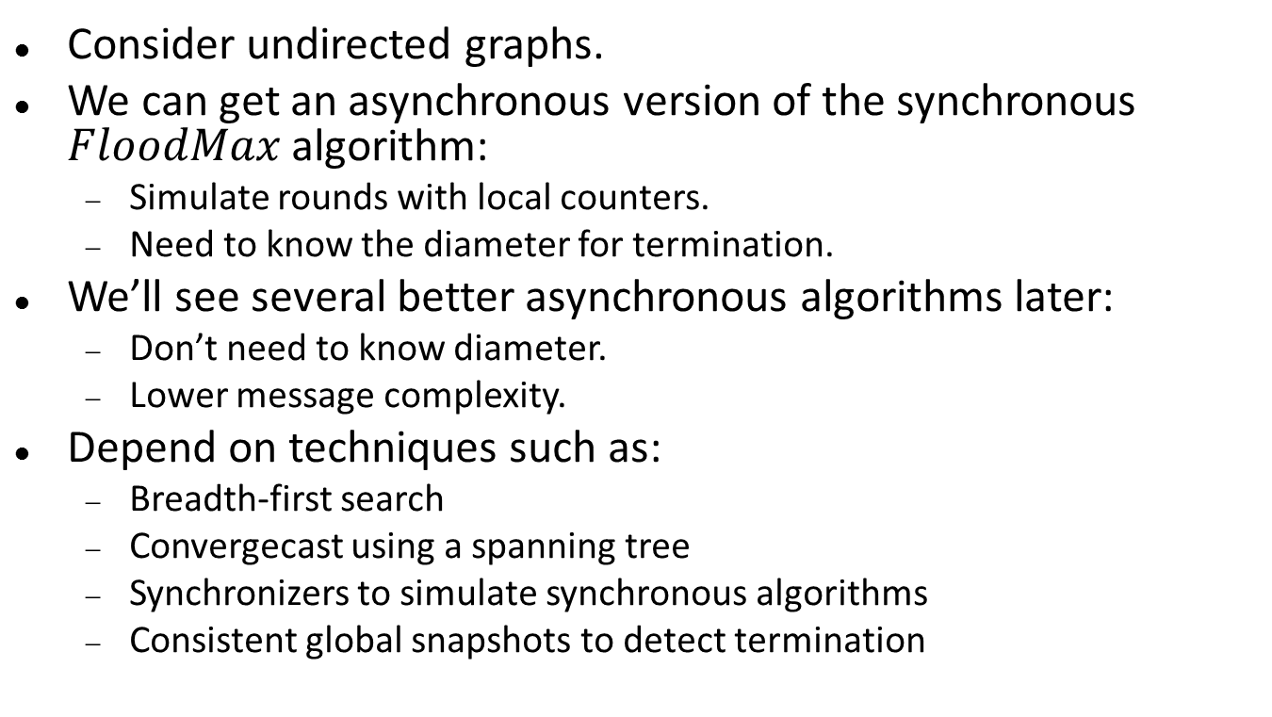
Component names and leaders
For every component with $level>1$, define the core edge of the component’s tree.
Defined in terms of the merge and absorb operations used to construct the component:
After merge: Use the common $MWOE$.
After absorb: Keep the old core edge of the higher-level component.
“The edge along which the most recent merge occurred.”
Component name: $(core, level)$
Leader: Endpoint of core edge with higher id.

Slide 60
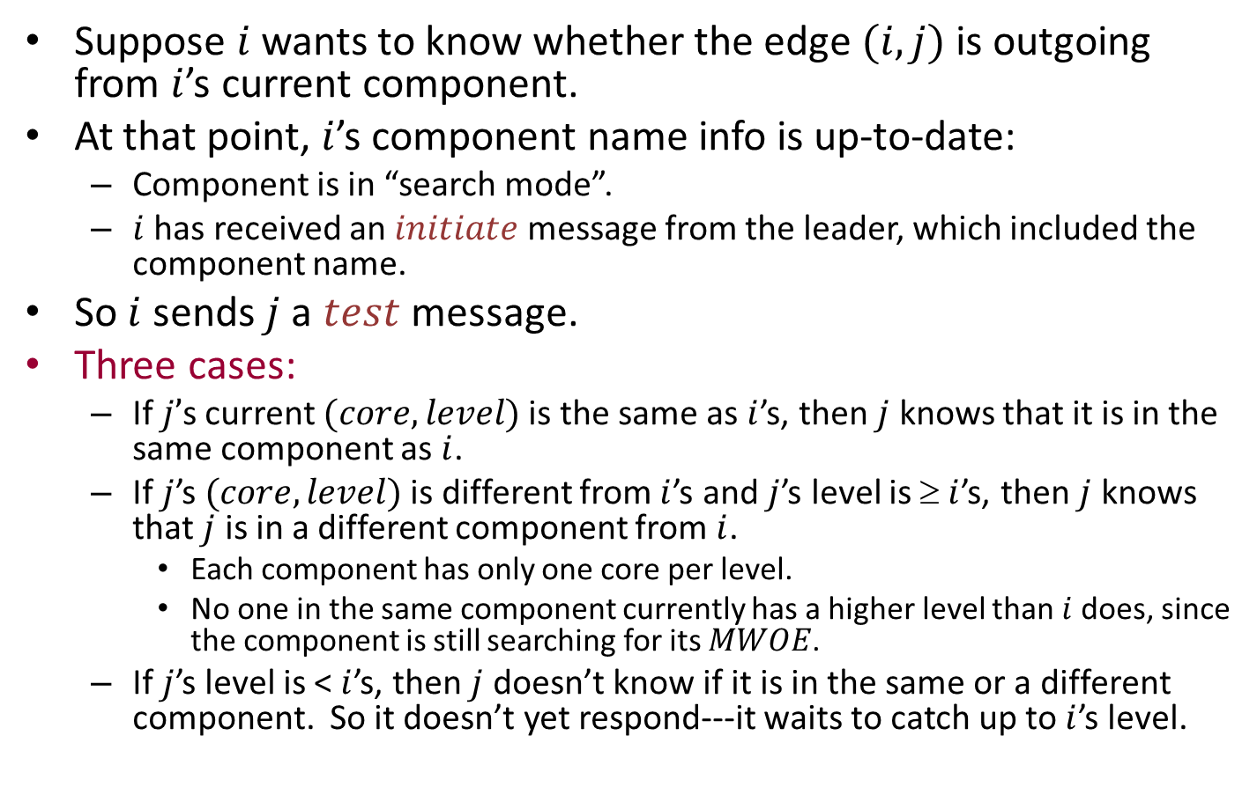
Determining whether an edge is outgoing
Suppose $i$ wants to know whether the edge $(i,j)$is outgoing from $i$’s current component.
At that point, $i$’s component name info is up-to-date:
Component is in “search mode”.
$i$ has received an $initiate$ message from the leader, which included the component name.
So $i$ sends $j$a $test$message.
Three cases:
If $j’$s current $(core, level)$is the same as $i$’s, then $j$ knows that it is in the same component as $i$.
If $j$’s $(core, level)$is different from $i$’s and $j$’s level is $ i$’s, then $j$ knows that $j$ is in a different component from $i$.
Each component has only one core per level.
No one in the same component currently has a higher level than $i$ does, since the component is still searching for its $MWOE$.
If $j$’s level is < $i$’s, then $j$ doesn’t know if it is in the same or a different component. So it doesn’t yet respond---it waits to catch up to $i$’s level.
Notes:
The algorithm is basically like the synchronous one.
Leaders initiate the searches throughout their component triees.
This slide addresses the local search part.
The second case is tricky---it’s really two cases:
If the levels are the same then the cores must be different, and the components are therefore different.
On the other hand, if j’s level is higher, then it can’t be in the same component because that component is currently searching.

Slide 61

Liveness, again
Q: Can the extra delays imposed here affect the progress argument?
No:
We can redo the progress argument, this time considering only those components with the lowest current level $k$.
All processes in these components must succeed in determining their $mwoe$s, so these components succeed in determining the component $MWOE.$
If any of these level $k$ components’ $MWOE$s leads to a higher level, then we can absorb.
If not then all lead to other level $k$ components, so as before, we must have two components that point to each other; so we can merge.

Slide 62
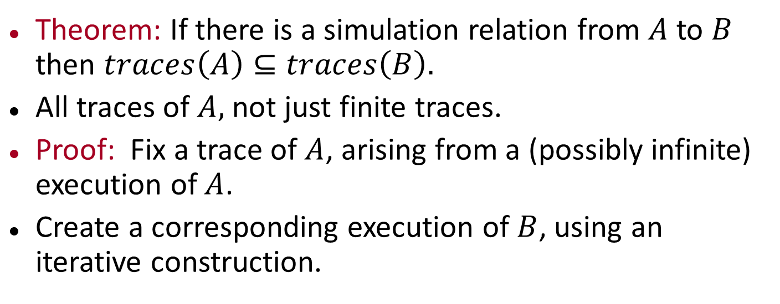

Interference between $MWOE$searches
Suppose $C$ gets absorbed into $C$ via an edge from $i$ to $j$, while $C$ is working on determining its $MWOE.$
Two cases:
When the absorb occurs, $j$ has not yet reported its local $mwoe$.
Then it’s not too late for $C$to include $C$ in its $MWOE$search. So $j$ passes the $initiate$ message into $C$.
$j$has already reported its local $mwoe.$
Then it’s too late to include $C$ in the search.
But it doesn’t matter: the $MWOE$ for the combined component can’t be outgoing from a node in $C$ anyhow!
Why not?
C′
C
MWOE(C)
C′
i
j
Notes:
This is imagining that the absorb occurs and j learns about it atomically. Later when we implement this at a finer level of granularity, the absorb will be defined to occur when i SENDS a connect message to j.
But this case analysis is based on when j RECEIVES the message.

Slide 63

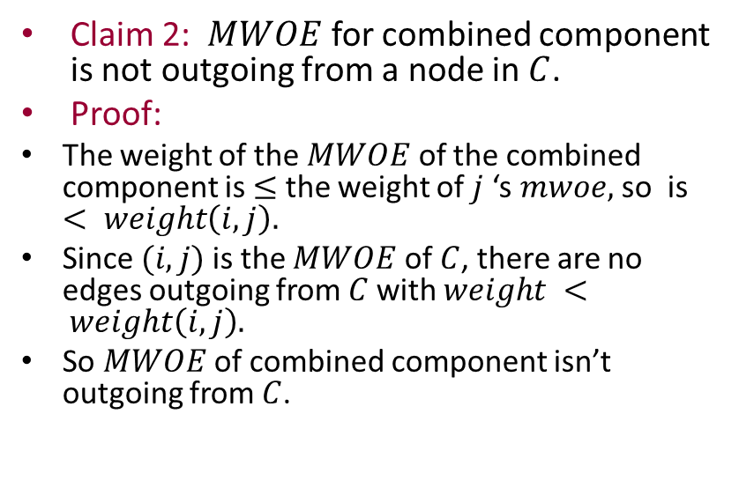
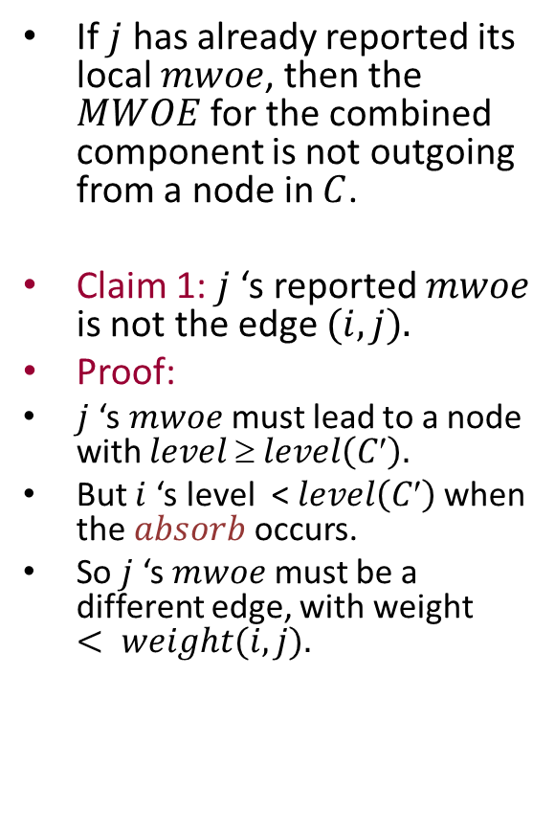
Interference between $MWOE$ searches
If $j$ has already reported its local $mwoe$, then the $MWOE$ for the combined component is not outgoing from a node in $C$.
Claim 1: $j$‘s reported $mwoe$ is not the edge $(i,j).$
Proof:
$j$‘s $mwoe$must lead to a node with $level ≥ level\left(C′\right).$
But $i$‘s level <$level\left(C′\right)$when the $absorb$ occurs.
So $j$‘s $mwoe$must be a different edge, with weight $< weight(i,j).$
C′
C
mwoe(C)
C′
i
j
Claim 2: $MWOE$ for combined component is not outgoing from a node in $C$.
Proof:
The weight of the $MWOE$ of the combined component is $≤$ the weight of $j$‘s $mwoe,$so is $< weight\left(i,j\right).$
Since $(i,j)$is the $MWOE$ of $C$, there are no edges outgoing from $C$with $weight < weight\left(i,j\right).$
So $MWOE$ of combined component isn’t outgoing from $C$.
Notes:
Since j already reported its mwoe, it must lead to a node that is “caught up”, that is, with level at least as high as the current level of C.

Slide 64
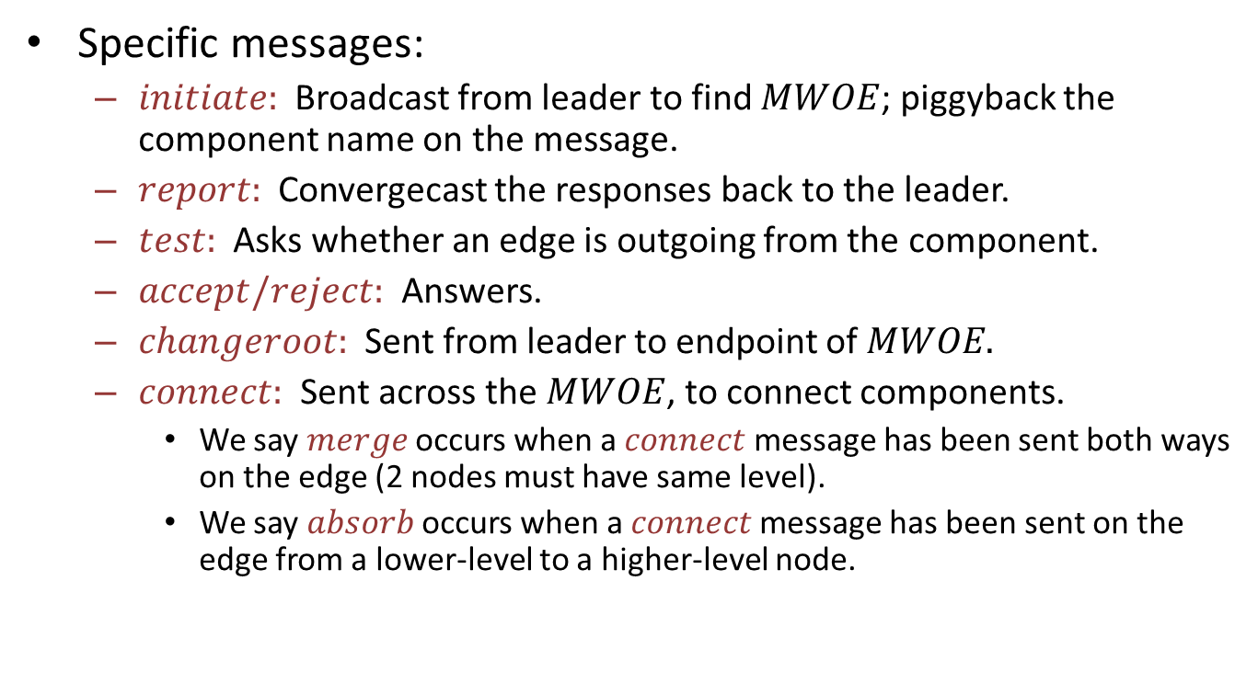
A few details
Specific messages:
$initiate:$Broadcast from leader to find $MWOE$; piggyback the component name on the message.
$report:$Convergecast the responses back to the leader.
$test:$Asks whether an edge is outgoing from the component.
$accept/reject:$ Answers.
$changeroot:$Sent from leader to endpoint of $MWOE.$
$connect:$Sent across the $MWOE$, to connect components.
We say $merge$ occurs when a $connect$ message has been sent both ways on the edge (2 nodes must have same level).
We say $absorb$ occurs when a $connect$message has been sent on the edge from a lower-level to a higher-level node.

Slide 65
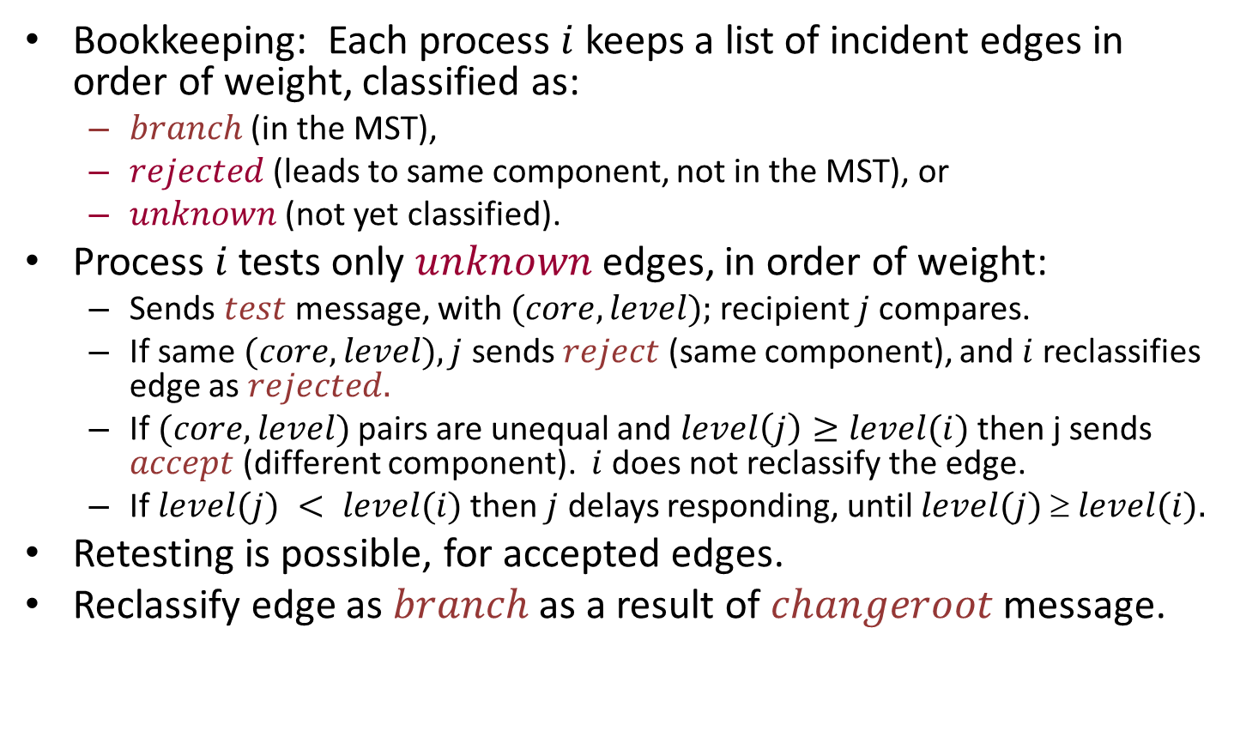
Test-Accept-Reject Protocol
Bookkeeping: Each process $i$ keeps a list of incident edges in order of weight, classified as:
$branch$ (in the MST),
$rejected$(leads to same component, not in the MST), or
$unknown$ (not yet classified).
Process $i$ tests only $unknown$edges, in order of weight:
Sends $test$message, with $(core, level);$recipient $j$compares.
If same $(core, level), j$ sends $reject$ (same component), and $i$reclassifies edge as $rejected.$
If $(core, level)$pairs are unequal and $level\left(j\right)≥level(i)$then j sends $accept$(different component). $i$ does not reclassify the edge.
If $level(j) < level(i)$then $j$ delays responding, until $level(j)  level(i).$
Retesting is possible, for accepted edges.
Reclassify edge as $branch$ as a result of $changeroot$message.

Slide 66
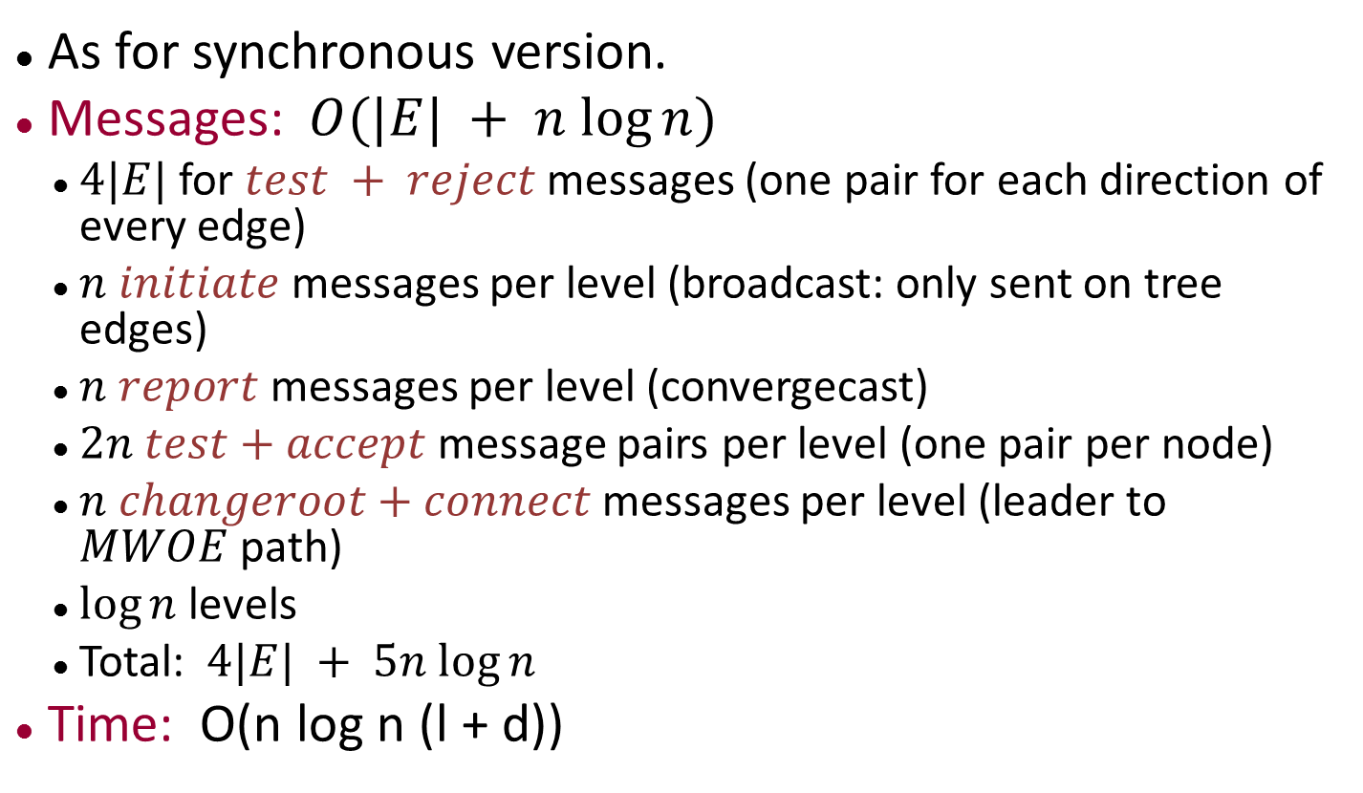
Complexity
As for synchronous version.
Messages: $O(|E| + n log⁡n)$
$4|E|$ for $test + reject$messages (one pair for each direction of every edge)
$n$ $initiate$ messages per level (broadcast: only sent on tree edges)
$n$ $report$ messages per level (convergecast)
$2n$ $test+accept$ message pairs per level (one pair per node)
$n$ $changeroot+connect$messages per level (leader to $MWOE$path)
$log⁡n$ levels
Total: $4|E| + 5n log⁡n$
Time: O(n log n (l + d))
Notes:
The time bound assumes all nodes wake up together, at time 0.
LTTR.

Slide 67
Proving Correctness
GHS MST is hard to prove, because it’s complicated.
GHS paper includes informal arguments.
Pretty convincing, but not formal.
Also simulated the algorithm extensively.
Many successful attempts to formalize, all complicated
Many invariants because many variables and actions.
Some use simulation relations.
Recent proof by Moses and Shimony.

Slide 68
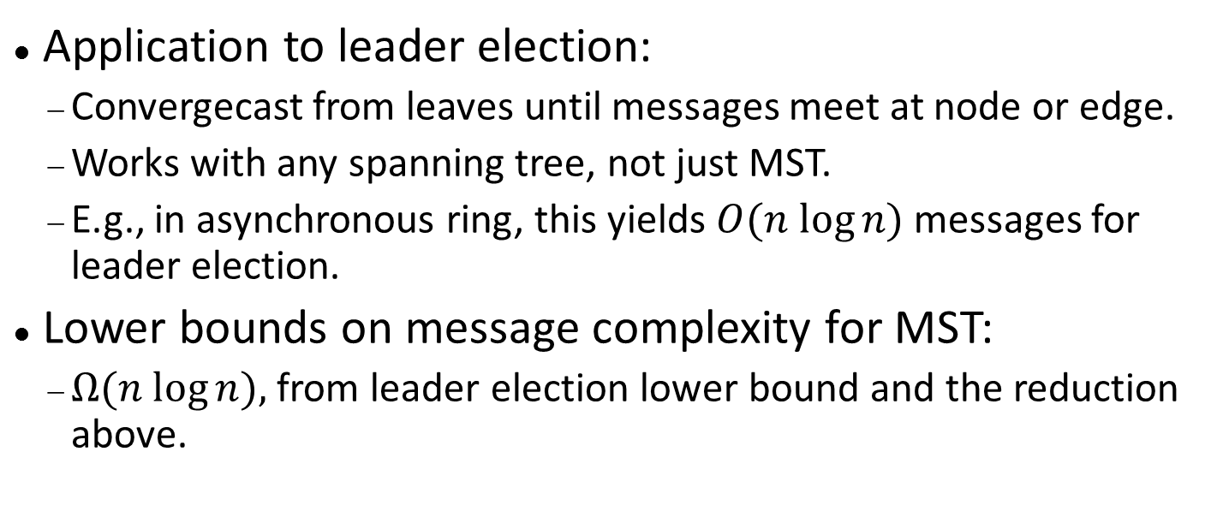
Minimum spanning tree
Application to leader election:
Convergecast from leaves until messages meet at node or edge.
Works with any spanning tree, not just MST.
E.g., in asynchronous ring, this yields $O(n log⁡n)$messages for leader election.
Lower bounds on message complexity for MST:
$Ω(n log⁡n),$from leader election lower bound and the reduction above.
Notes:
This leader election algorithm works in arbitrary graphs, nodes don’t need to know anything about the graph.
Actually, the GHS algorithm yields a leader as a by-product.
Lower bound: Considering MST in unknown graph, so we can use the leader election lower bound, which works for an unknown ring.

Slide 69
Next time
Synchronizers
Reading: Chapter 16

